Slide 1


Building the World’s Capacity to Protect Children & Strengthen Families
Removing Youth from Sex Offender
Registries: Promoting Justice, Safety
and Fairness
Janet Rosenzweig MS, PhD, MPA, Senior Policy Analyst
Mike Nowlin MSSA, LISW-S, Director of Operations
1706 E. Broad Street, Columbus, OH 43203 www.ihs-trainet.com

Slide 2
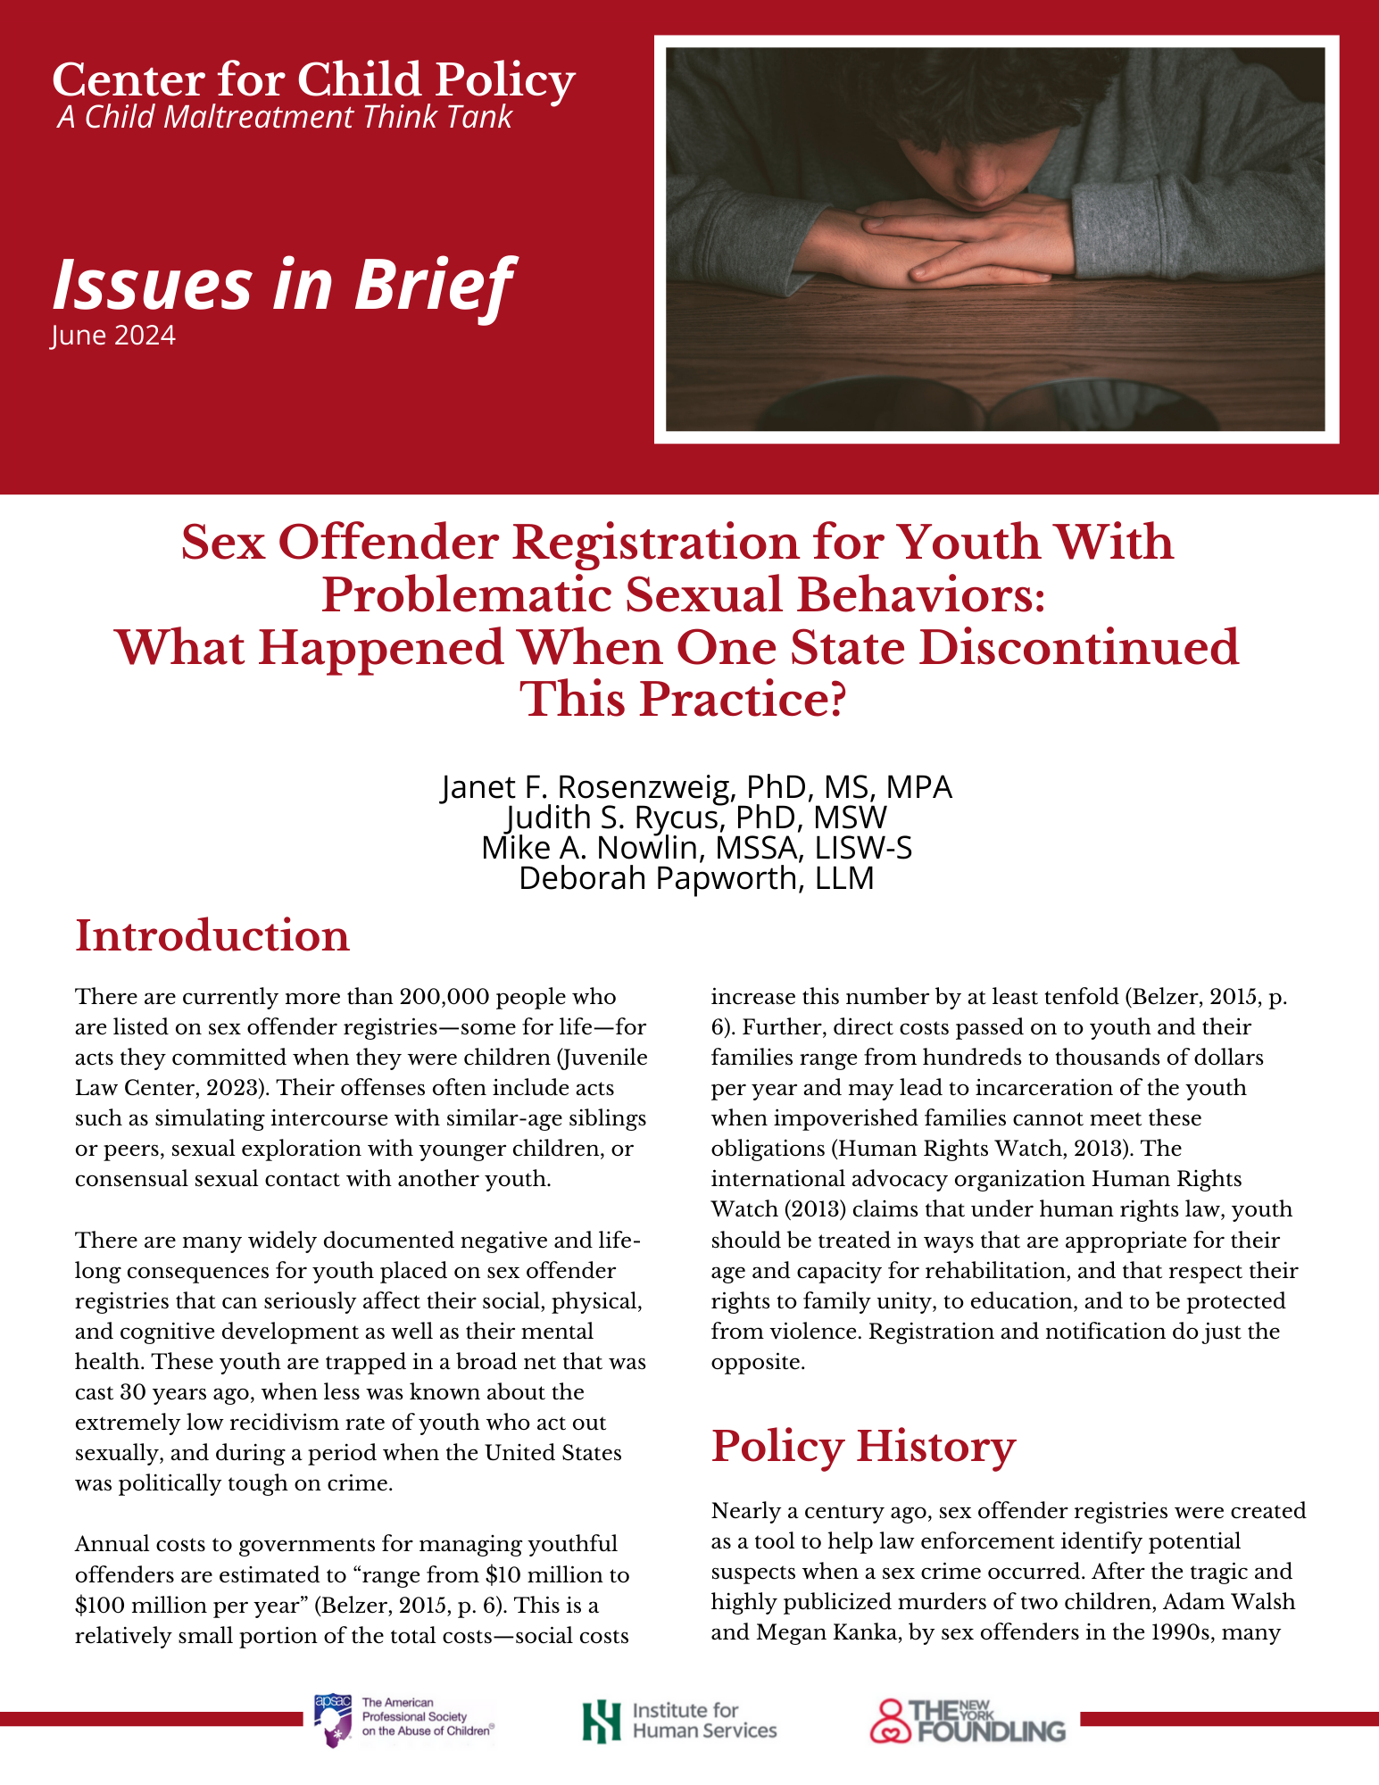
Objectives
We will review the research on juveniles who act out sexually from clinical, legal and policy perspectives.
We will present data on the incidence of juvenile sex crimes in one state that stopped registration.
We will introduce the public policy concept of ‘crime control theater’: laws with no demonstratable effect that are too popular with the public to repeal.
We will offer specific calls to action for
advocates.

Slide 3

Download the
Issues in Brief
It is also available through the conference app as a handout for this session

Slide 4
Note About References
All data and research results presented in these slides are fully referenced in the document “Removing youth from sex offender registries: What happened when one state discontinued this practice ” being shared today.
Please do not use or distribute these slides without the accompanying paper.

Slide 5
Introduction
There are currently more than 200,000 people who are listed for life on sex offender registries for acts they committed when they were children (Juvenile Law Center, 2023).
  acts such as simulating intercourse with similar-age siblings or peers, sexual exploration with younger children, or consensual sexual contact with another youth.
Annual costs to governments for managing youthful offenders are estimated to “range from $10 million to $100 million per year” (Belzer, 2015 p.6).
  Social costs increase this by at least ten-fold.
Direct costs passed on to youth and their families range from hundreds to thousands of dollars per year and may lead to incarceration of the youth when impoverished families cannot meet these obligations (Human Rights Watch 2013).

Slide 6

Policy History – How did we get here?
Historical & Social Contexts
The first state sex offender registry was introduced in 1947 (CA), but used locally earlier as a tool to help law enforcement identify potential suspects when a sex crime occurred.
After the tragic and highly publicized murders of two children, Adam Walsh and Megan Kanka, by sex offenders in the 1990s, many states created sexual offender registries and made community notification and publication of information from these registries the norm.
In July 2006, President Bush signed the Adam Walsh Child Protection and Safety Act into federal law, mandating that all states create/maintain registries.

Slide 7

Strategic Environment 1990’s:
The Myth of the ‘Super Predator’
This federal mandate coincided with an increase in youth crime at the same time that some of the key provisions of the juvenile justice system, developed in the 1950’s and 1960’s, were being rescinded. Together, this set the stage for youth with problematic sexual behaviors to be swept up in the same net as violent sex offenders.
The ‘super predator’ myth: The term was coined in 1995 after a criminologist extrapolated from a study in Philadelphia that showed that 6% of the kids known to the juvenile justice system accounted for more than half of the serious crimes.
‘He blamed these chronic offenders on “moral poverty…the poverty of being without loving, capable, responsible adults who teach you right from wrong.” DiIulio warned that by the year 2000 an additional 30,000 young “murderers, rapists, and muggers” would be roaming America’s streets, sowing mayhem.
Analysis: How the media created a 'superpredator' myth that harmed a generation of Black youth (nbcnews.com) Read this NBC news analysis!
https://www.nbcnews.com/news/us-news/analysis-how-media-created-superpredator-myth-harmed-generation-black-youth-n1248101

Slide 8
Strategic Environment: The Neutered 90’s
Megan's Laws NJ, 1994 (first) federal 1996
  Sex abuse prevention became checking registries
  Adults were concerned about being falsely accused by a child or parent
Abstinence only education funding 1996
  Limited topics to be presented in classes
  Even well-intentioned adults stopped talking to kids about sex
  Youth had less and less access to accurate information about sexuality – could have been related to an increase in sexually acting out?
Jocelyn Elders—US Surgeon General--1994
Dr. Joycelyn Elders, the highly qualified US Surgeon General was forced to resign after replying to a specific question at a World AIDS Day conference asking if she "thought that masturbation could serve as a useful tool to help discourage school children from becoming sexually active too early" by saying: "With regard to masturbation, I think that is something that is part of human sexuality and a part of something that perhaps should be taught".
Foes of her superior, President Clinton, painted the public health official as a pervert.

Slide 9

Point:
While laws were being enacted that had lifelong consequences for youth who acted out sexually, restrictions increased on access to resources that promote healthy sexual development.
This is further exacerbated now by youth having more access to pornography than quality sex information.
This Photo by Unknown Author is licensed under CC BY-NC-ND

Slide 10

SORNA
Early Legislation
The federal Adam Walsh Act has seven major Titles. Title I, the Sex Offender Registration and Notification Act (SORNA), listed a comprehensive set of minimum standards to regulate sex offender registration and notification.
    States were forced to implement by July 2009 or face a 10% reduction in state funding
Youth had to be included in registration and community notification activities by 2011.
  committed an offense after their 14th birthday,
  And adjudicated delinquent for a crime comparable to or more severe than aggravated sexual abuse as defined in federal law (Sexual Abuse Act of 1986)

Slide 11
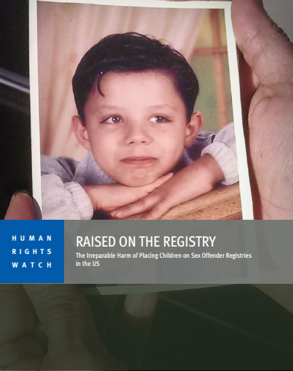
An International Spotlight
The international advocacy organization, Human Rights Watch claims that under human rights law, youth should be treated in ways that are appropriate for their age, their capacity for rehabilitation, and that respect their rights to family unity, to education, and to be protected from violence (Human Rights Watch, 2013).
Registration and notification do just the opposite.

Slide 12

Unintended Consequences of Registration for Youth
Harassment and unfair treatment
Segregation from nuclear family
Educational disruption
Financial burdens on their family
Increased risk of suicide
Increased risk of being approached by an adult for sex
  Especially if reporting to a public building, with others on the registry for annual check-ins.

Slide 13
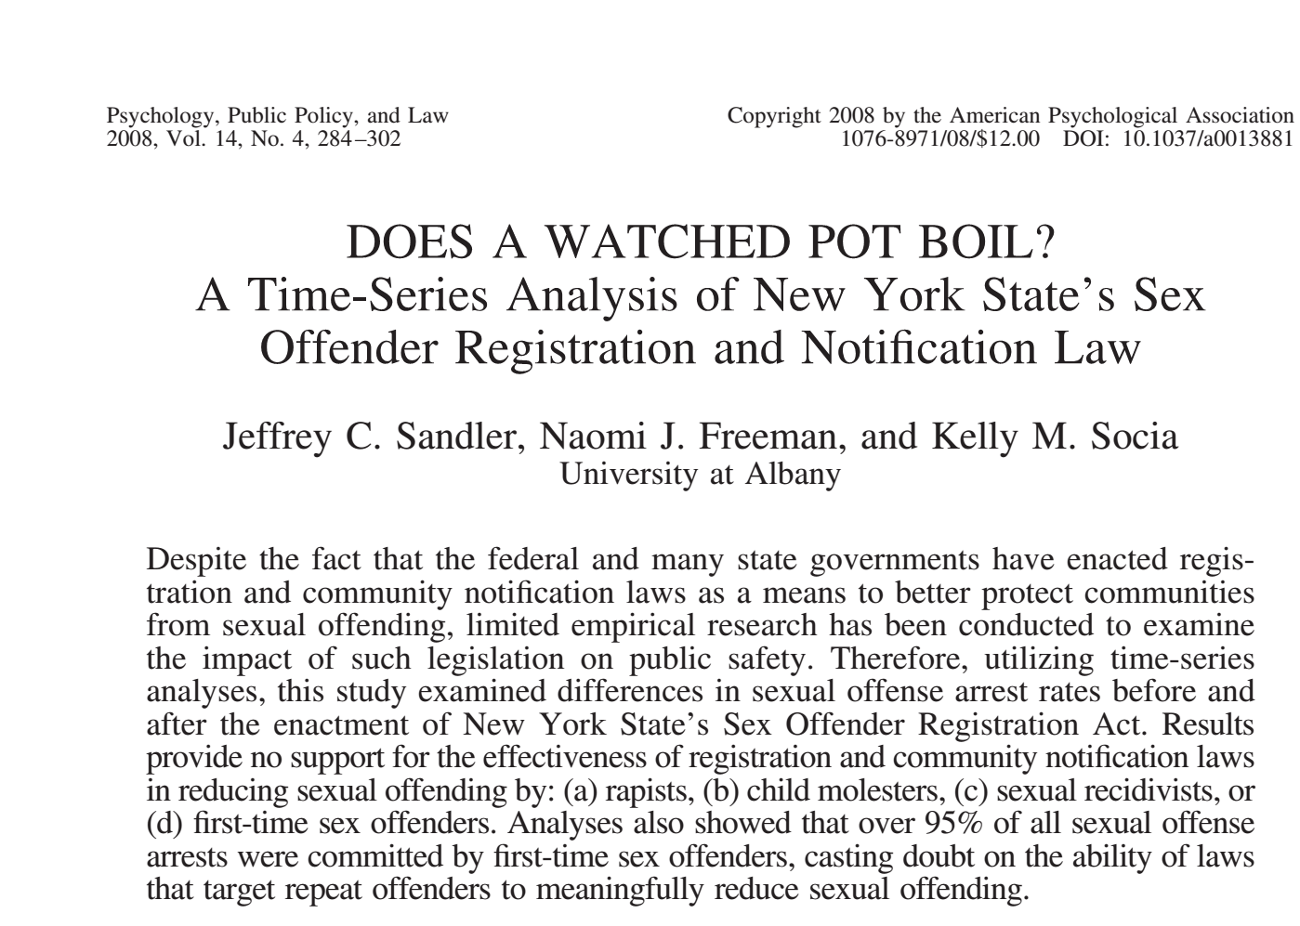
Sex Offender Registries:
A Policy With No Effect on Rates of Abuse
“Results provide no support for the effectiveness of registration and community notification laws…”
Results of the analyses indicated that the 1996 enactment of NY SORA (and thus the beginning of the registry) had no significant impact on rates of total sexual offending, rape, or child molestation, whether viewed as a whole or in terms of offenses committed by first-time sex offenders or those committed by previously convicted sex offenders (i.e., repeat offenders).”
Notes:
recap

Slide 14
More Research….
“I use three separate data sets and designs to determine whether sex offender registries are effective. First, I use state-level panel data to determine whether sex offender registries and public access to them decrease the rate of rape and other sexual abuse. Second, I use a data set that contains information on the subsequent arrests of sex offenders released from prison in 1994 in 15 states to determine whether registries reduce the recidivism rate of offenders required to register compared with the recidivism of those who are not. Finally, I combine data on locations of crimes in Washington, D.C., with data on locations of registered sex offenders to determine whether knowing the locations of sex offenders in a region helps predict the locations of sexual abuse.
The results from all three data sets do not support the hypothesis that sex offender registries are effective tools for increasing public safety.”
Sex Offender Registries: Fear without Function? Amanda Y. Agan The Journal of Law & Economics Vol. 54, No. 1 (February 2011), pp. 207-239

Slide 15
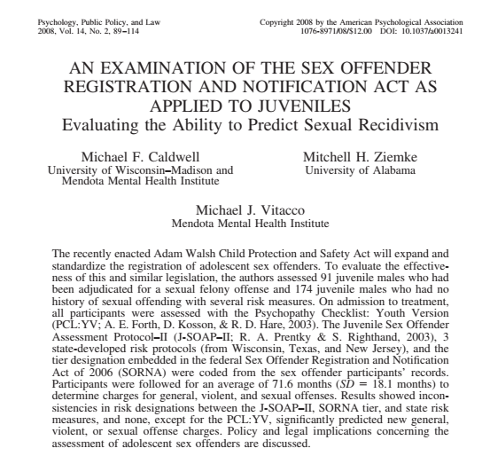
Research: What About States That Use a Risk Prediction Tool?
“Results showed inconsistencies in risk designations between the J-SOAP–II, SORNA tiers, and state risk measures, and none, except for the PCL:YV, significantly predicted new general, violent, or sexual offense charges. (Psychopathology checklist: Youth Version)
Note that juveniles who did reoffend in this study have ‘extremely high PCL:YV scores’ with all pathology not necessarily related to sexuality.
This finding ‘cuts across sex offenders and non-sex-offending delinquents alike” (page 106)
Please read this article for a detailed discussion on how little validity there is among assessment measures!

Slide 16
The Risk to Youth May Be Increasing
2009 Sex Offender Management Assessment & Planning Initiative Report (SOMAPI)
  Youth account for 35.6% of reported offenses against youth
    Juveniles Who Commit Sex Offenses Against Minors (ojp.gov) https://www.ojp.gov/pdffiles1/ojjdp/227763.pdf
    Sexual Abuse and Assault in a Large National Sample of Children and Adolescents (Gerwitz-Meydan and Finkelhor 2020)
      ”Results indicate most offenses are at the hands of other juveniles (76.7% for males and 70.1% for females), primarily acquaintances, and occurring more frequently for adolescents aged 14–17.”
    More current reports show that number increasing, particularly technology facilitated offenses

Slide 17
A Growing Body of Evidence
The rate of recidivism is lower for problematic sexual behaviors than for many other types of juvenile offenses (see, for example, Borduin et al., 2009).
Sex offender treatment appears to be more successful with adolescents than it is with adult offenders (Kim et al., 2015).
Community-based treatments have a larger effect in reducing recidivism when compared to institutionally based treatments. The findings reported in Bourdin et al. (2009) highly support this conclusion.
Both individual studies and synthesis research suggests that therapeutic interventions for youth who sexually offend can and do work (Pryzbylsky, 2015).

Slide 18
Evidence Based Treatment
The Armand et. al meta-analysis of treatment interventions for children with problematic sexual behaviors (2008)showed the importance of community-based treatment because the primary agent of change for youth sexual behavioral problems appears to be the youth’s parent or caregiver who is engaged in the treatment process.
In practice, certain provisions of registration and notification laws make it impractical, if not impossible, for youth to access community-based treatment, creating yet another unintended negative consequence of registration.

Slide 19
Weighing the Costs of Registries
Annual costs to governments for managing youthful offenders are estimated to “range from $10 million to $100 million per year” (Belzer)
Add Indirect costs and this number goes up 10x
Costs to victims e.g. inability to leave state for college; check-ins expose them to predators
Costs to families e.g. multiple dwellings, separation of families
Costs to communities e.g. lost tax revenue as property values decrease in a neighborhood with a registered offender

Slide 20
Cost Effectiveness asks “What does it cost to achieve my effect?”
Dopp, et. al, in 2017 dollars
Evaluated 6 sites using the CBT variant designed for youth with PSB’s
  Looked at 6 sites: in 5 of the 6 sites the average cost was below $4,000 per youth (one site was an outlier at $37,612. See the article for details.)
  Included costs of staff training in the evidence-based model

Slide 21
Cost Benefit Asks: Was It Worth It?
Treatment is certainly cheaper than registries
The CDC estimated costs for dealing with one case of child sexual abuse is estimated to be:
Lowest end $210,012 in 2010 dollars

Slide 22

To further the policy objective of removing youth from registries, we need empirical evidence to support the clinical evidence of the harms of registration.
Our Child Maltreatment Policy Resource Center undertook a two-year process to identify states who were considered by advocates to be least likely to place youth on registries.
Linklaters, an international law firm, provided a pro bono team to analyze laws in six states identified by advocates.

Slide 23

In 2014, after a suit brought by The Juvenile Law Center, The Pennsylvania State Supreme Court ruled that placing juveniles on sex offender registries was unconstitutional.
Read the ruling here!
Pennsylvania Supreme Court Rules Sex Offender Registration Unconstitutional for Youth | Juvenile Law Center (jlc.org)

Slide 24
Highlights from the Opinion
“While adult sexual offenders have a high likelihood of re-offense, juvenile sexual offenders exhibit low levels of recidivism… many of those who commit sexual offenses as juveniles do so as a result of impulsivity and sexual curiosity. [T]he vast majority of youth are unlikely to recidivate,” wrote Justice Baer”
The Court reasoned that in the area of sexual offenses “many acts of delinquency involve immaturity, impulsivity, and sexual curiosity rather than hardened criminalist.”

Slide 25
Highlights Continued
The Court found that the label also negatively affects children’s “ability to obtain housing, schooling, and employment, which in turn hinders their ability to rehabilitate,” noting the onerous reporting requirements necessary for youth on the registry.
The Court also reasoned that SORNA contradicts the Juvenile Act’s specified purpose. Specifically, Pennsylvania courts are “mandated to always be watchful of juveniles’ rehabilitation, while also providing accountability to the victim and society,” but “SORNA’s automatic registration removes the juvenile judges’ ability to consider the rehabilitative prospects of individual juvenile sexual offenders.”

Slide 26
Our Research Project
Disclaimers
The data utilized in the processing of Pennsylvania Juvenile Court Judges’ Commission data were generated by, belongs to and made available by the National Juvenile Court Data Archive, which is maintained by the National Center for Juvenile Justice in Pittsburgh, Pennsylvania, and supported by a grant from the Office of Juvenile Justice and Delinquency Prevention, U.S. Department of Justice. NCJJ bears no responsibility for the analyses of interpretations presented therein. Points of view or opinions contained within this document are those of the author and do not necessarily represent the official position or policies of the Juvenile Court Judges’ Commission.

Slide 27
Methodology
Our Research Process
The Pennsylvania data files were obtained after executing an agreement with the National Center for Juvenile Justice, which was approved by the Pennsylvania Juvenile Justice Commission.
The files contain data on cases after they are closed; therefore, using a file created in 2022, we used only cases with an open date of 2019 or earlier.
This is an incidence study, not a recidivism study; the unit of observation is a charge.

Slide 29
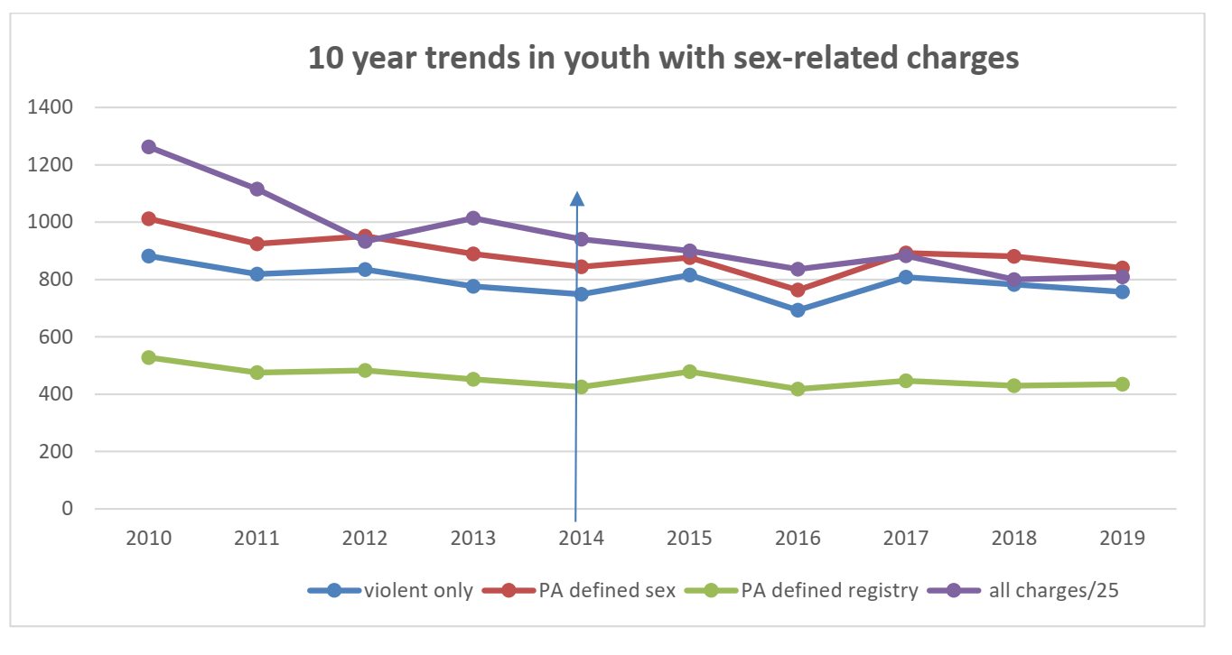

Slide 30
Additional Analyses
To test the importance of registration as a predictor of the number of sex-related charges during this 10-year period, we ran a regression analysis using the dataset adjusted for lagged cases, with a 0/1 dummy variable for the presence or absence of the registration requirement.
There was no statistical significance for the registration variable when the model included the year (t=-.624, sig. 552) or when run as a bivariate model with the dependent variable (t=-756, sig=.472).

Slide 31
Abstract of Findings
The trend in the incidence of sex related charges in Pennsylvania Juvenile Court did not change after a Pennsylvania State Supreme Court Ruling in 2014 discontinued the practice of placing youth on sex offender registries.
The trend in sex-related juvenile court referrals generally mirrors the trend for all juvenile court referrals.
These findings support the work of researchers and advocates who urge an end to the practice of placing juveniles on sex-offender registries.

Slide 32
Confounding Policy Issues | Description
Registries as Crime Control Theater | Refers to the issue of public policies or programs which have been found to have no effect but are too popular with the public to terminate
Wide Variation Between States | In the laws, policies or procedures In judicial approaches In assessing risk In updating laws to reflect court cases
Challenges in Promoting Legal Changes | No one want to be seen as soft on sex offenders or for not protecting children

Slide 33
Current Issues for Advocacy
Reframing youth with problematic sexual behaviors as a public health problem
Promoting evidenced based treatment
Trying youth as adults
Have the number of cases changed in the states who have changed their policies about registration and notification for youth?
  PA data shows it has not
  Other state data coming soon

Slide 34
Take Aways:
Potential applications to your work
Sex Offender registries are NOT effective prevention tools!
Expanding them may make little sense, and in fact does more harm by casting a wide net that catches people who pose no danger.
  This is especially true for youth; note the work of Elizabeth Letourneau at the Moore Center at Johns Hopkins
Advocacy point: The cost of registries could have been used to support evidence-based interventions, which registries clearly are not.
  Once source to cite on cost: In 2006, The Congressional Budget Office estimated that it would cost $1.5 Billion over 5 years to implement The Adam Walsh Child Protection and Safety Act. (See Sandler et. al)

Slide 35

Calls to Action to Promote Justice and Equity
Learn about your state policies affecting youth with problematic sexual behaviors
Replace the term ‘juvenile sex offender’ with ‘youth with problematic sexual behaviors’ and advocate for peers and colleagues to do likewise
Access the research findings on youth with problematic sexual behaviors and use it to educate others about the lack of effectiveness of registration and notification, and the ensuing serious harms for youth.

Slide 36


Calls to Action to Promote Justice and Equity
Use and share the resources offered by The National Center on the Sexual Behavior of Youth (NCSBY).
Work within your communities to move the investment of public funds from registries and enforcement to supporting professionals to deliver evidence-based interventions.
Implementing the Adam Walsh Act of 2006 was conservatively estimated to cost $300,000,000 per year in direct costs (Sandler at al. 2008), and social costs can increase that by 10-fold with little social benefit (Belzer 2015).
Evidence-based community treatment is estimated to cost less than $5,000 per child (Dopp, et al., 2020), and primary prevention even less.
www.ncsby.org

Slide 37
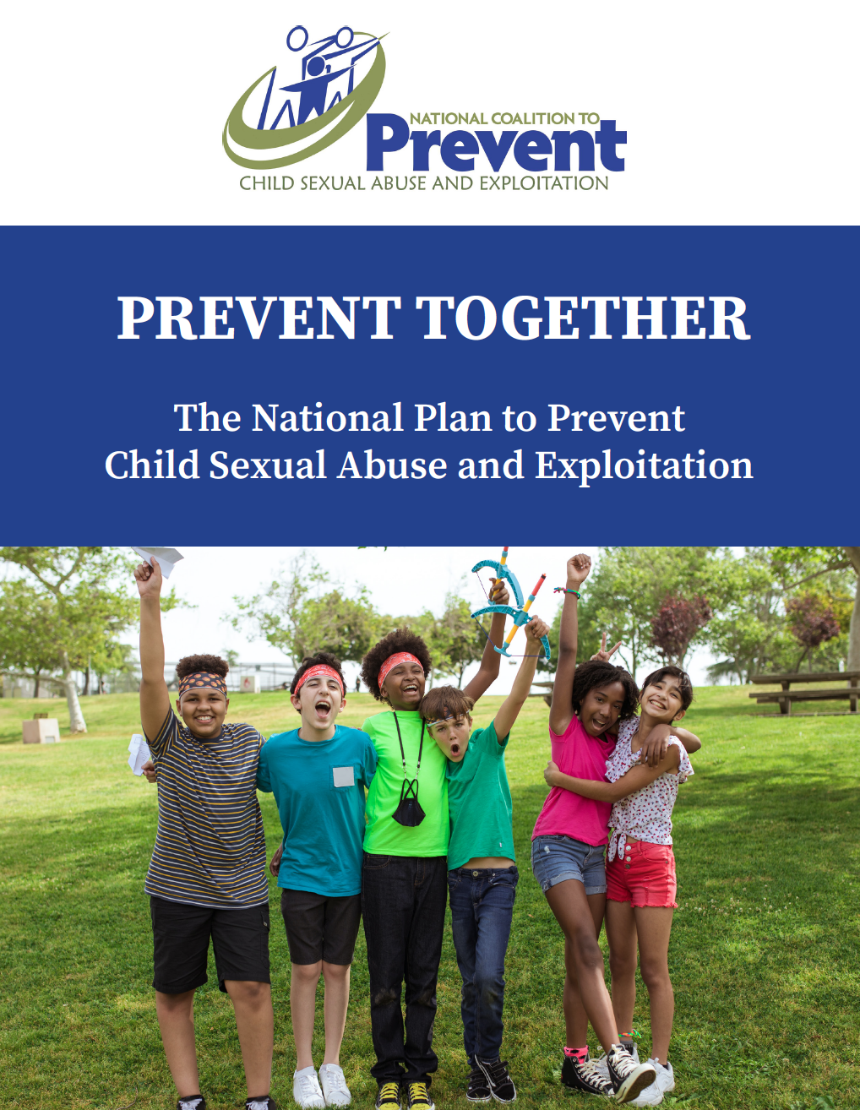
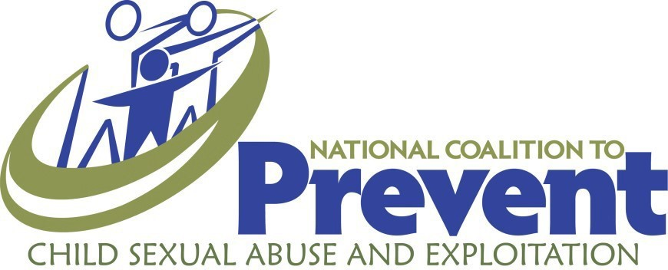
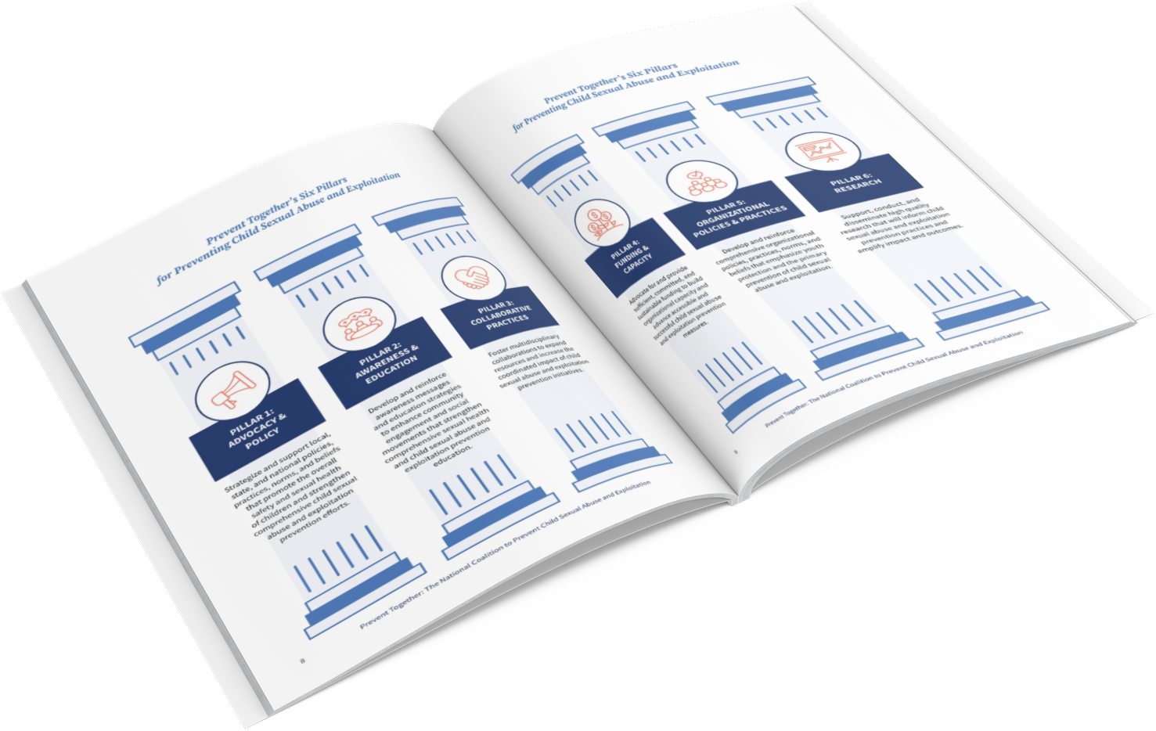
A National Plan to Prevent Child Sexual Abuse and Exploitation
www.PreventTogether.org
Notes:
Prevent Together has developed a National Plan to Prevent Child Sexual Abuse and Exploitation to provide a framework for effective, comprehensive, and holistic prevention interventions that are culturally sensitive, include survivor and marginalized voices, strengthen child-friendly environments for collective impact, and act as a catalyst for social change for protecting children from sexual abuse and exploitation.
First national plan published in 2008 with six key action areas to promote prevention
Updated in 2012 and again in 2021.

Slide 38
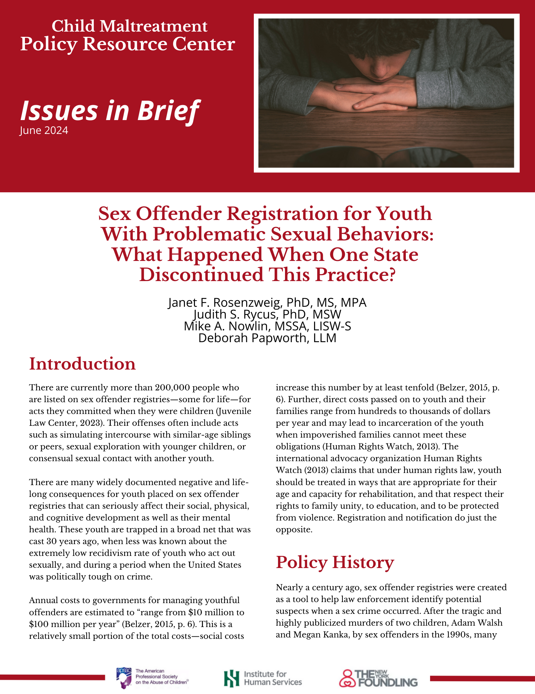
Download the
Issues in Brief
Dr. Janet Rosenzweig
Senior Policy Analyst
Institute for Human Services
Columbus, OH
Jrosenzweig@ihs-trainet.com

Slide 41
Removing Youth from Sex Offender Registries: Promoting Justice, Safety and Fairness
A presentation developed for
The Family Violence Prevention Research Conference

Slide 42
Jocelyn Elders
1994 Dr. Joycelyn Elders, U.S. Surgeon General, was forced to resign after replying to a specific question at a World AIDS Day conference.
When asked if she “thought that masturbation could serve as a useful tool to help discourage school children from becoming sexually active too early” she stated, “With regard to masturbation, I think that is something that is part of human sexuality and a part of something that perhaps should be taught.”
Foes of Elders’ superior, President Bill Clinton, repeated this one sentence out of context, seeking to paint a dedicated public health official as a pervert who wanted curricula on how to masturbate taught in grade schools.

Slide 43
The policy to place juveniles on registries was developed during an era when: ADD bluewhen
The myth of the “super predator” was alive and well
Anything that had to do with sex was stigmatized

Slide 44
Restricted Sex
Education
Abstinence only education:
limited finding 1982
massive infusion, 1996
Funded both schools and youth serving agencies
Specified topics that could be covered
Youth had less and less access to accurate information about sexuality – could have been related to an increase in sexually acting out?
What happened when adults spoke frankly about sex to youth in the ’90’s?

Slide 45
One Result??
Adults, even well-intentioned ones
STOPPED TALKING TO KIDS ABOUT SEX!
Talk about sexuality issues was highly restricted!

Slide 46
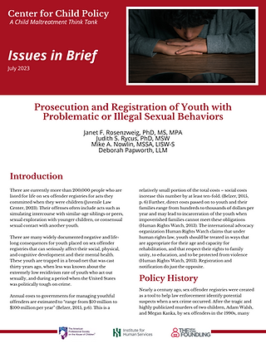
This issue is even more egregious for youth

Slide 47
The Bottom Line: No Impact on Rates
“results of the analyses indicate that the 1996 enactment of SORA (and thus the beginning of the registry) had no significant impact on rates of total sexual offending, rape, or child molestation, whether viewed as a whole or in terms of offenses committed by first-time sex offenders or those committed by previously convicted sex offenders (i.e., repeat offenders).”
-page 297

Slide 48
Freakonomics Agrees
Listen to this podcast:
http://freakonomics.com/podcast/making-sex-offenders-pay-and-pay-and-pay-and-pay-a-new-freakonomics-radio-podcast/

Slide 49
Costs
Aggregated annual costs to governments for managing juveniles ranges from $10 million to $100 million per year ( Belzer)
There are addition costs to families, schools, communities

Slide 50
Treatment works, recidivism is low, and nothing seems to change when we stop putting kids on registries!
The following slides are references that support this claim

Slide 51
Confounding Policy Issues
Wide Variations Among States
In the laws, policies or procedures
In judicial approaches
In assessing risk
In updating laws to reflect court cases

Slide 52
Confounding Policy Issues
Challenges in promoting legal changes:
No one wants to be portrayed as either soft of sex offenders or not a protector of children

Slide 53
Confounding Policy Issues
Registries as Crime Control Theater
Crime control theater refers to the issue of public policies or programs which have been found to have no effect but are too popular with the public to terminate

Slide 54
Current Issues for Study and Advocacy

Slide 55

Listen! This American Life: Help Wanted
A young man recognizing his attraction to children, wants help
https://www.thisamericanlife.org/radio-archives/episode/522/tarred-and-feathered?act=2

Slide 56
Current Issues for Study and Advocacy
Trying youth as adults

Slide 57
Current Issues for Study and Advocacy
Have the number of cases changed in the states who have changed their policies about registration and notification for youth?
Pennsylvania data shows it has not!
Additional states analysis coming!

